Slide 1
Blending machine learning, graph theory and spectral analysis to better understand student engagement and regulation*
Following the white rabbit of trace data
* Otherwise known as Couldn’t think of a shorter title

Slide 2
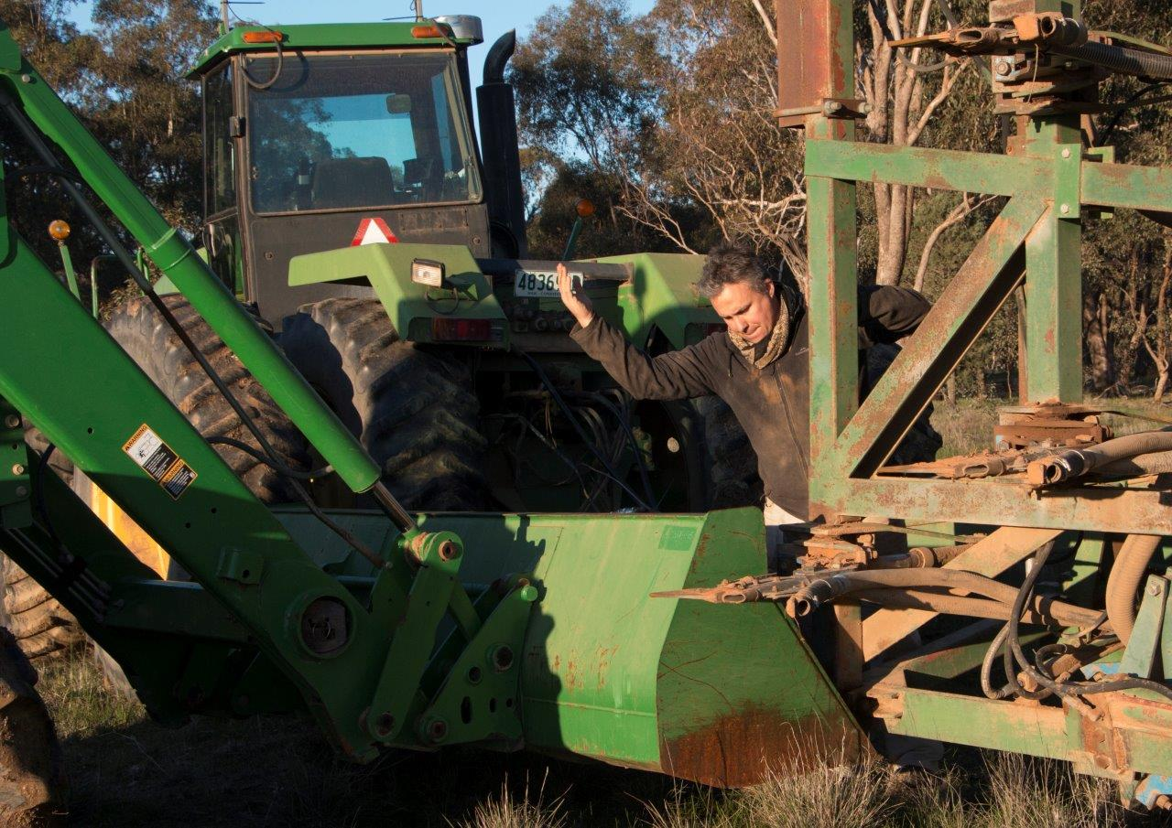
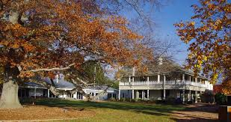
This session
Ben Hicks
Charles Sturt University
Notes:
Me; initially environmental & financial modelling, then teaching (include walkthroughs), then farming leading to learning analytics at CSU.

Slide 3
This session
Ben Hicks
Charles Sturt University
Menu:
Themes (Questions, Mapping)
Story (Examples of Clustering, Spectrums, SNA, maybe TDA)
Thinking and talking time
Play time
Notes:
Menu outline; start with broad themes / lessons.
Story – delving into one analysis.

Slide 4
This session
Me, Ben Hicks
Menu:
Themes (Questions, Mapping)
Story (Examples of Clustering, Spectrums, SNA, maybe TDA)
Thinking and talking time
Play time
Notes:
The darker slides mean do stuff

Slide 5
Questions
Far better an approximate answer to the right question, which is often vague, than an exact answer to the wrong question, which can always be made precise
-- Tukey, 1962

Slide 6
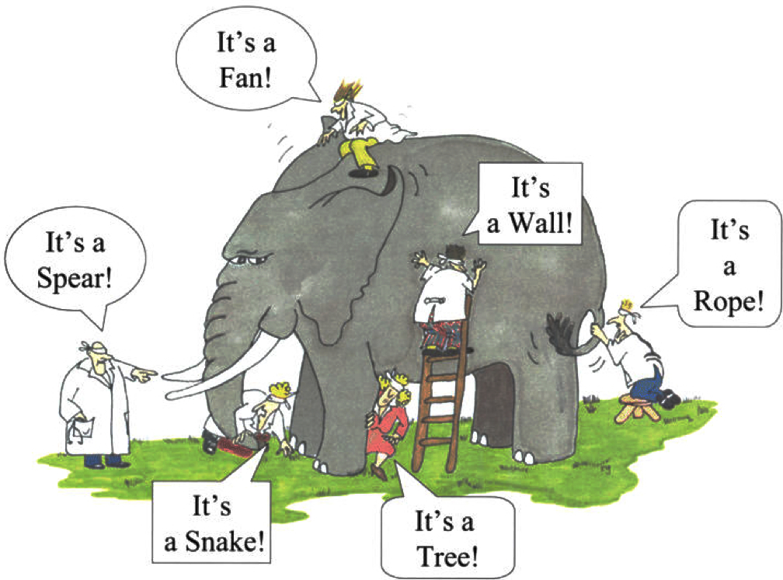
Questions
Notes:
My example is exactly like this, but just trying to lift blindfold a bit

Slide 7
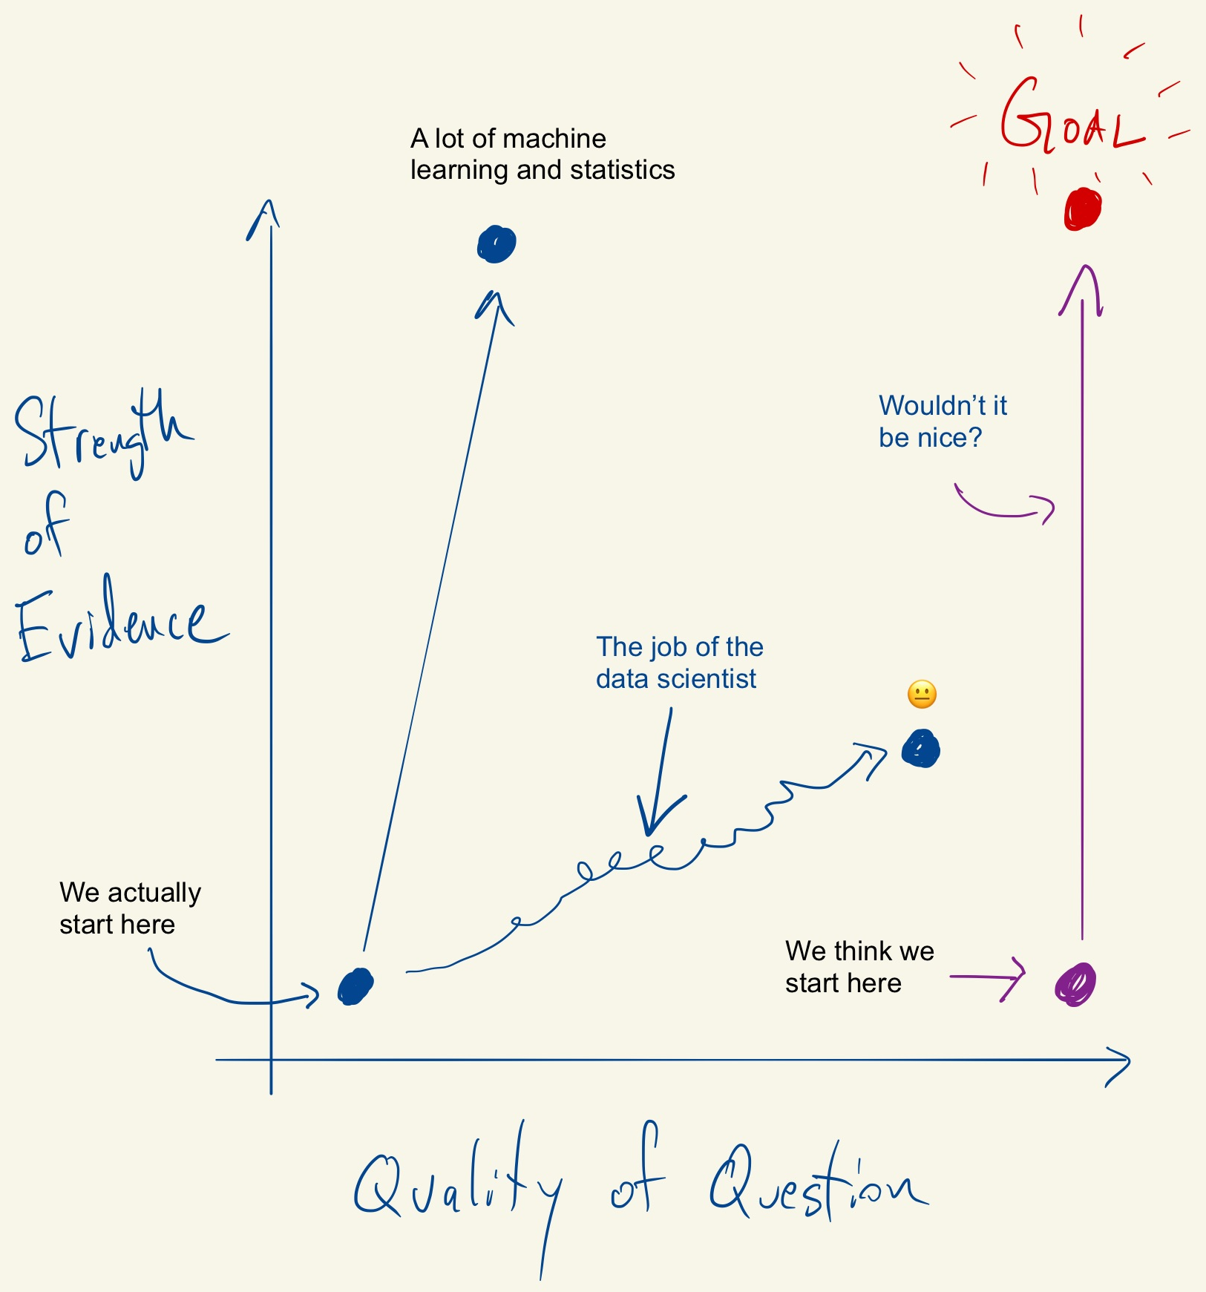
Roger Peng [2019]
https://simplystatistics.org/2019/04/17/tukey-design-thinking-and-better-questions/

Slide 8
Questions - Example
How did students engage with the content?
Did the forums assist learning?

Slide 9
Mapping
Raw Data
Tidy Data
Question
Cleaning, Wrangling
Visualisation
Grouping, Aggregating
Modelling
Embedding
Machine Learning
Feature Engineering

Slide 10
Mapping
Raw Data
Tidy Data
Question
Mapping
Analysis

Slide 11
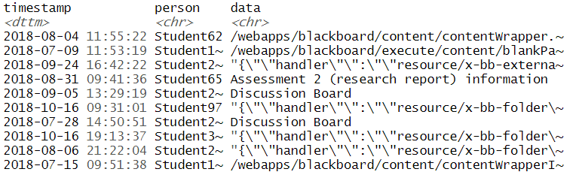
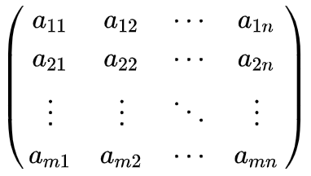
Mapping - Example
When
Who
What
Mapping

Slide 12
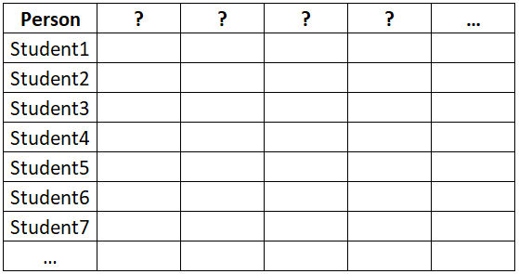
How did students engage with the content?
When
Who
What
Mapping

Slide 13
How did students engage with the content?
What did I miss?
Which feature / variable do you think will discriminate student behaviour the most? The least?
Which feature / variable do you think will discriminate student academic performance the most? The least?
Notes:
Hand out 1 - Refer to handout of the variables chosen for the mapping / feature generation.

Slide 14
How did students engage with the content?
What did I miss?
Which feature / variable do you think will discriminate student behaviour the most? The least?
Which feature / variable do you think will discriminate student academic performance the most? The least?
Notes:
Talk about mean(timestamp), median(timestamp) and possibly sd(timestamp)

Slide 15
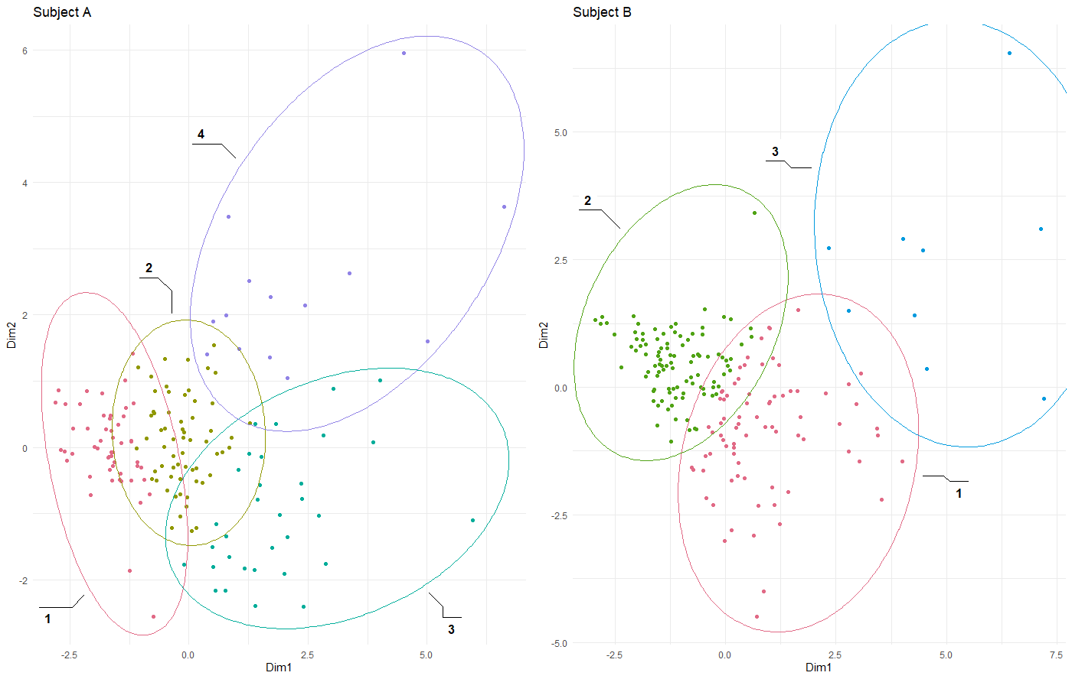
How did students engage with the content?
Notes:
Handout 2 – Clusters. Discuss the groups. How might you classify them?

Slide 16
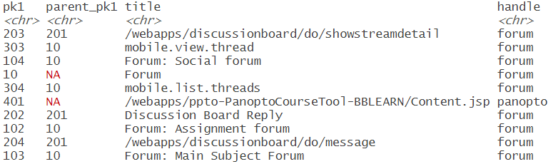
How did students engage with the content?
Forum

Slide 17
How did students engage with the content?
Forum
mobile.view.thread
Forum: Main Subject forum
mobile.list.threads
Forum: Assignment forum
Forum: Social forum

Slide 18
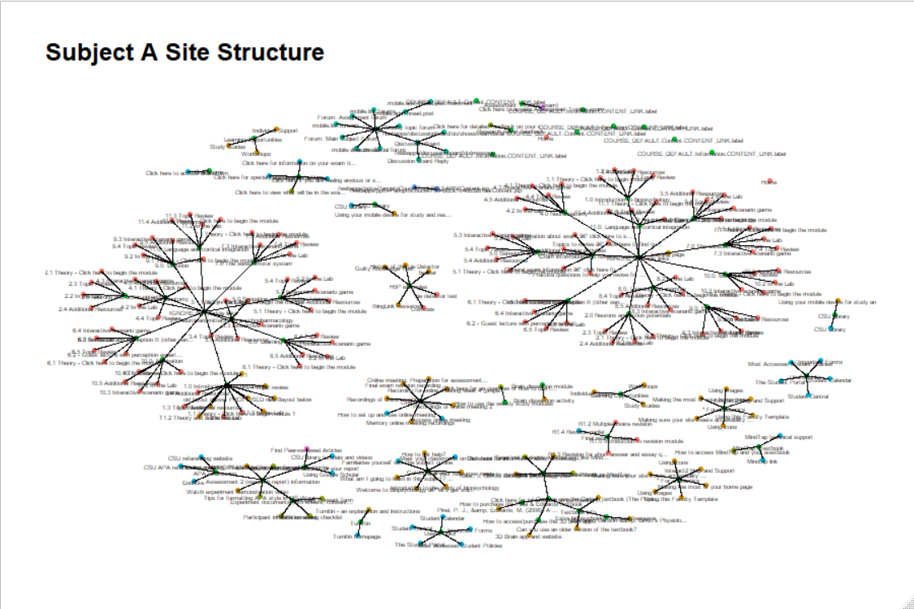
How did students engage with the content?

Slide 19
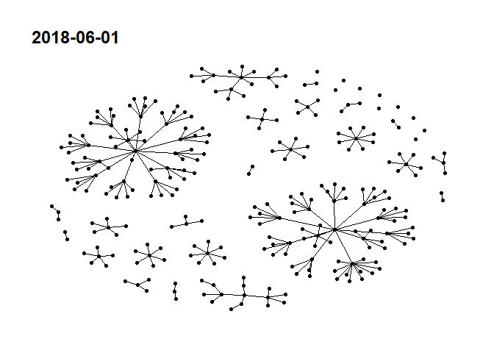
How did students engage with the content?

Slide 20
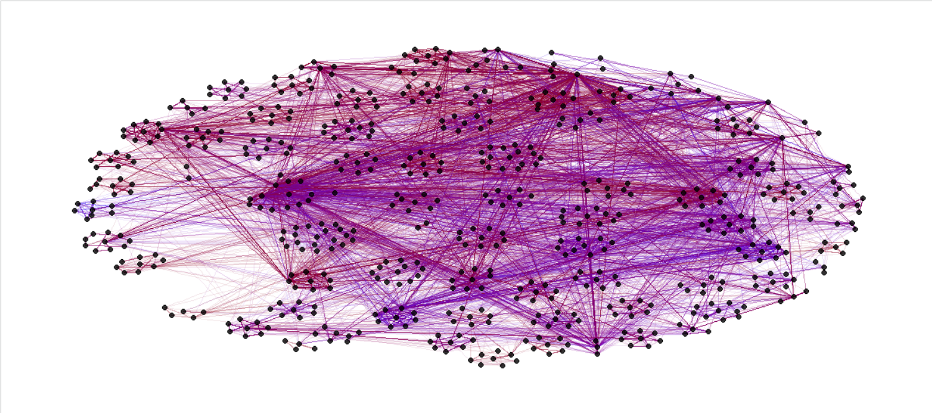
How did students engage with the content?

Slide 21
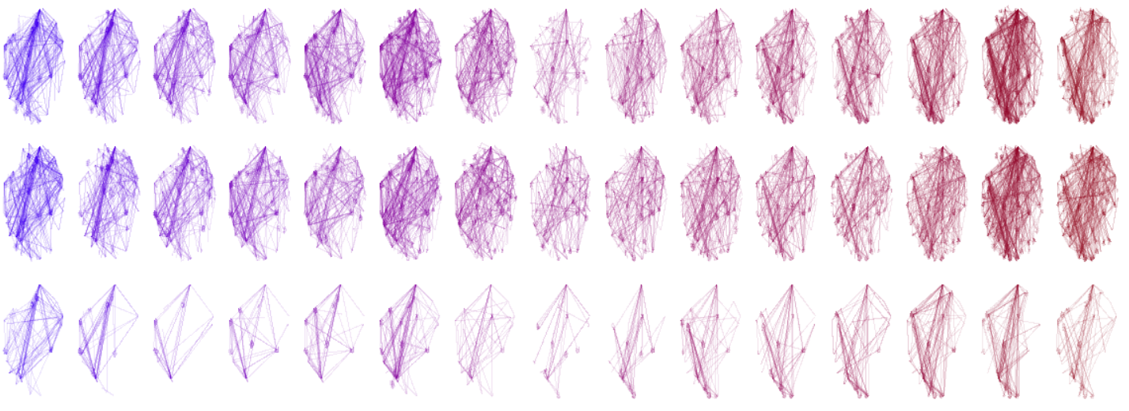
How did students engage with the content?
Time goes left to right, clusters are 1, 2, 3 from top to bottom

Slide 22
How did students engage with the content?
Look at the spaces (duration) in between the clicks
Evaluate the relative frequency of these durations
Effectively a Fourier Transform, but for impulses instead of a signal
Notes:
Return of the blind man – this time listening to clicks. Can they hear when someone loses focus? When they are engaged?

Slide 23
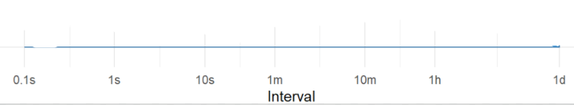
How did students engage with the content?
Notes:
Return of the blind man – this time listening to clicks. Can they hear when someone loses focus? When they are engaged?

Slide 24
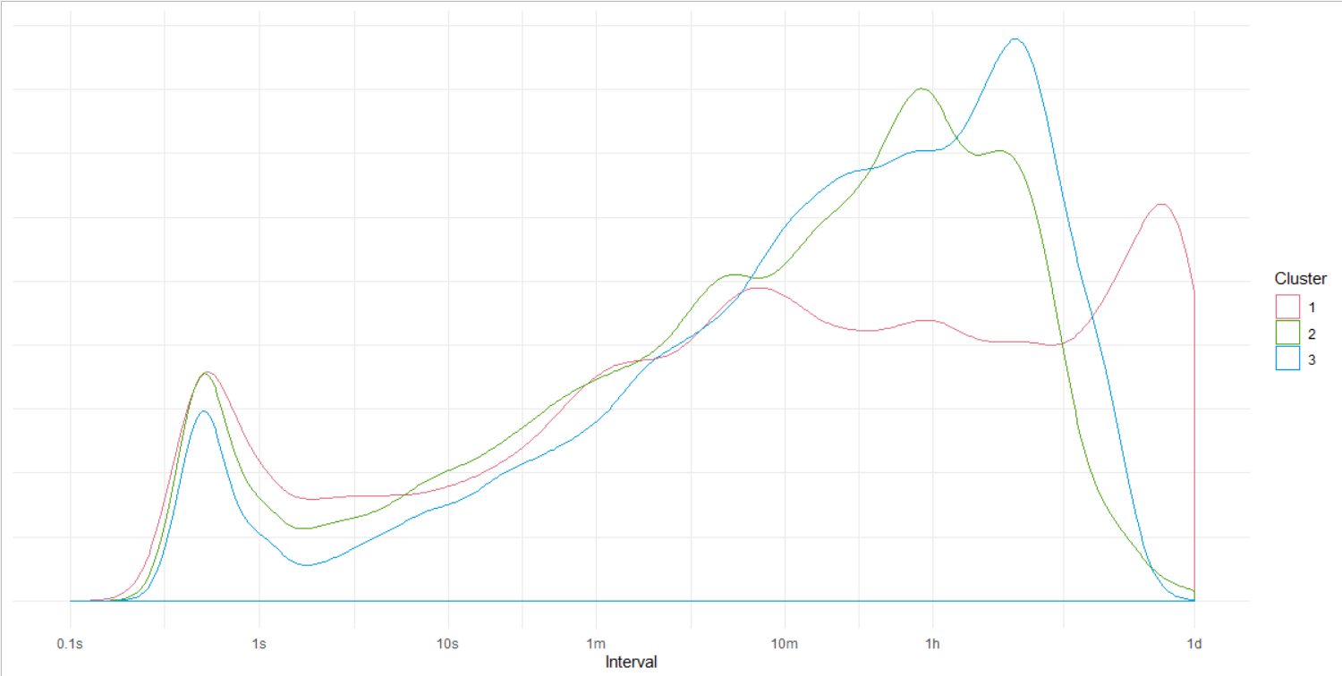
How did students engage with the content?
Subject B
Notes:
Return of the blind man – this time listening to clicks. Can they hear when someone loses focus? When they are engaged?

Slide 25
Did the forums assist learning?
Explore forum network layered with other data such as academic performance
Explore the structural changes in the forum network from one year to the next

Slide 26
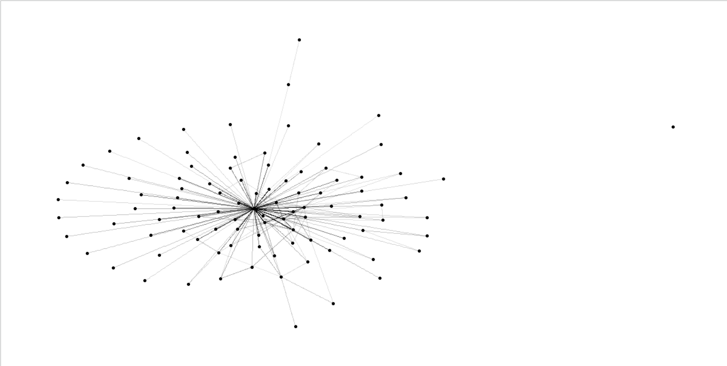
Did the forums assist learning?
Each node (point) is a person
Each edge (line) is a collection of forum replies between the two people.
The darkness of the line represents how many times those forum posts were viewed.

Slide 27
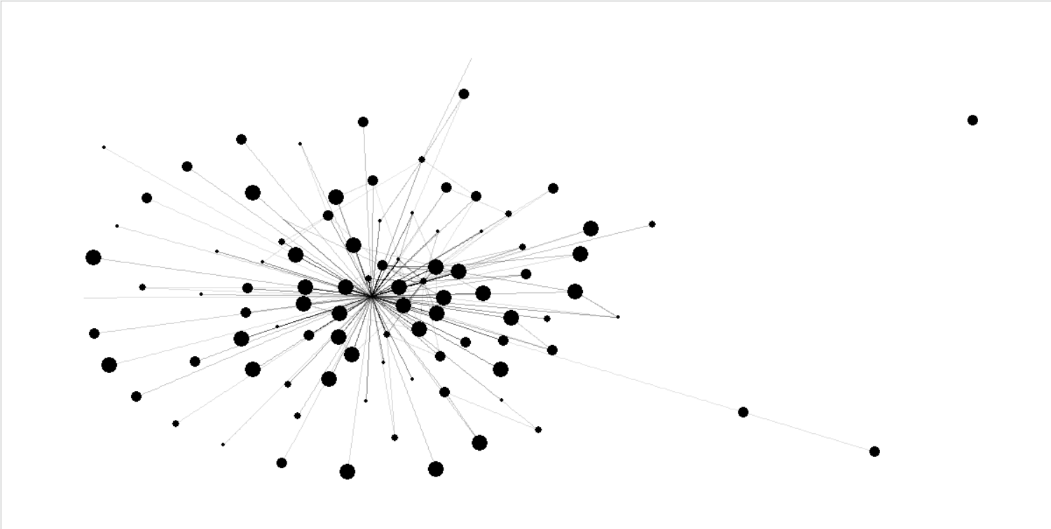
Did the forums assist learning?
The size of the node represents academic performance, larger is better

Slide 28
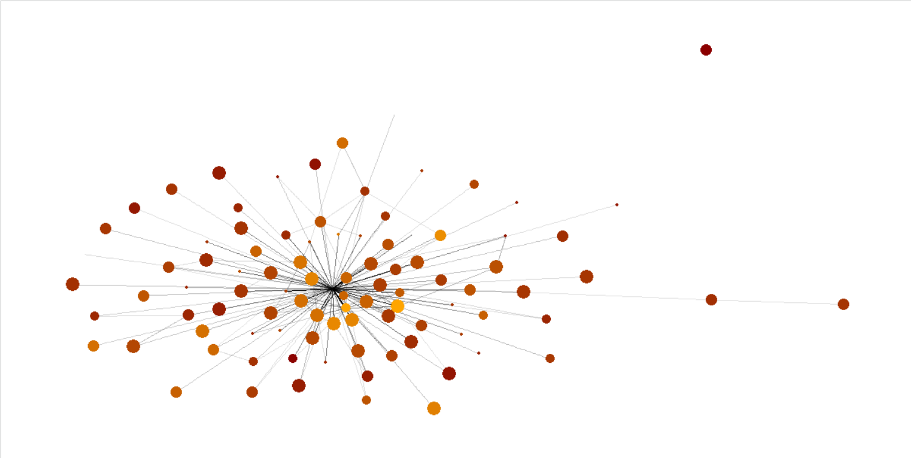
Did the forums assist learning?
The colour of the node represents forum views, darker and redder for less.

Slide 29
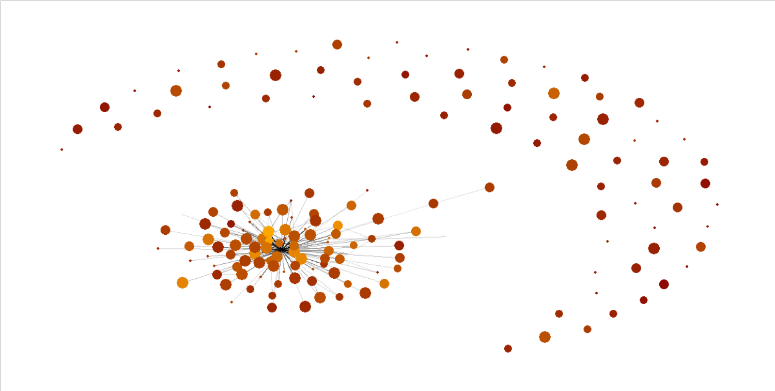
Did the forums assist learning?

Slide 30
Did the forums assist learning?
Comparing forums:
Visually
Density
Reciprocity
Transitivity
Triadic Census

Slide 31
Play time
Explore a mock data set: https://ben-hicks.shinyapps.io/TraceData/
For the R enthusiast, code is available @
https://github.com/benwhicks/alasi.2019 https://github.com/benwhicks/lakit

Slide 32
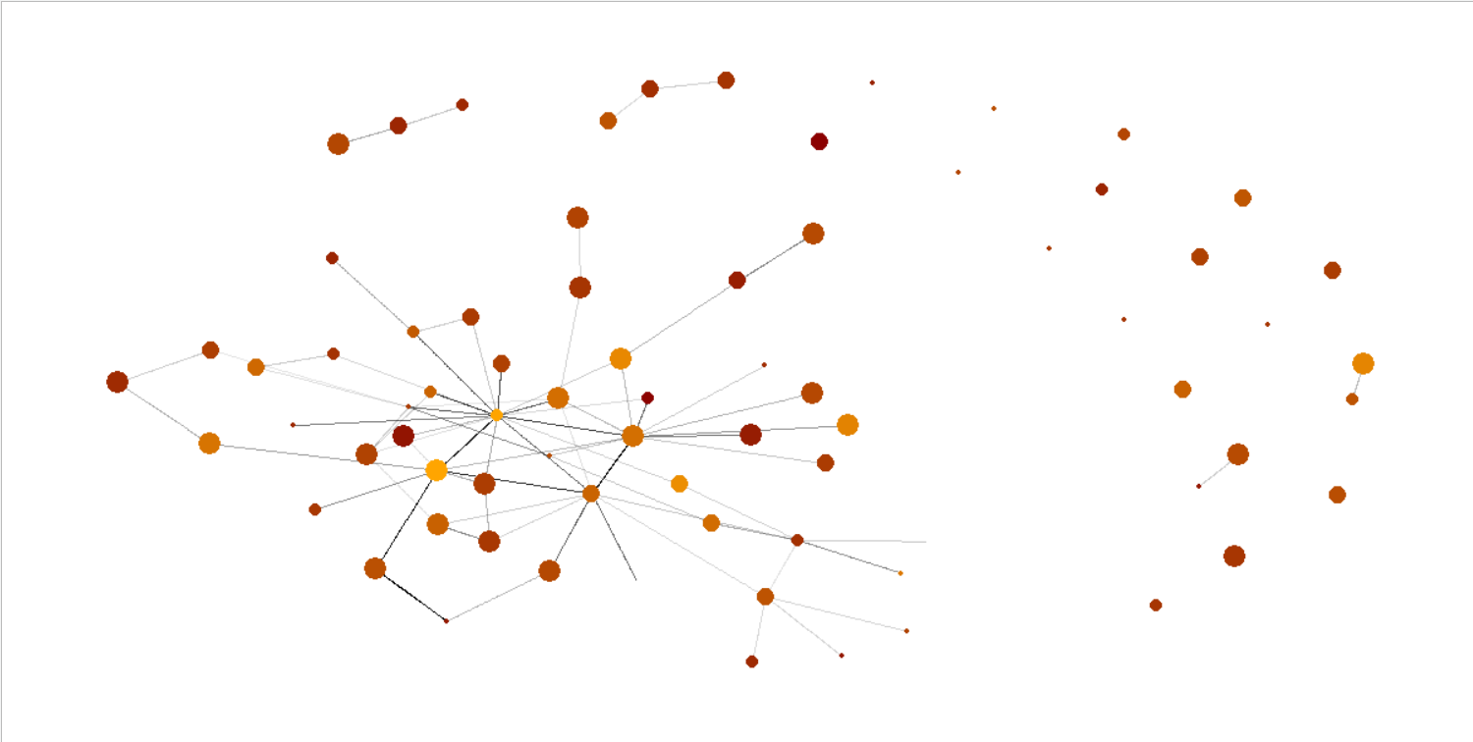
2018 Forum, teacher removed

Slide 33
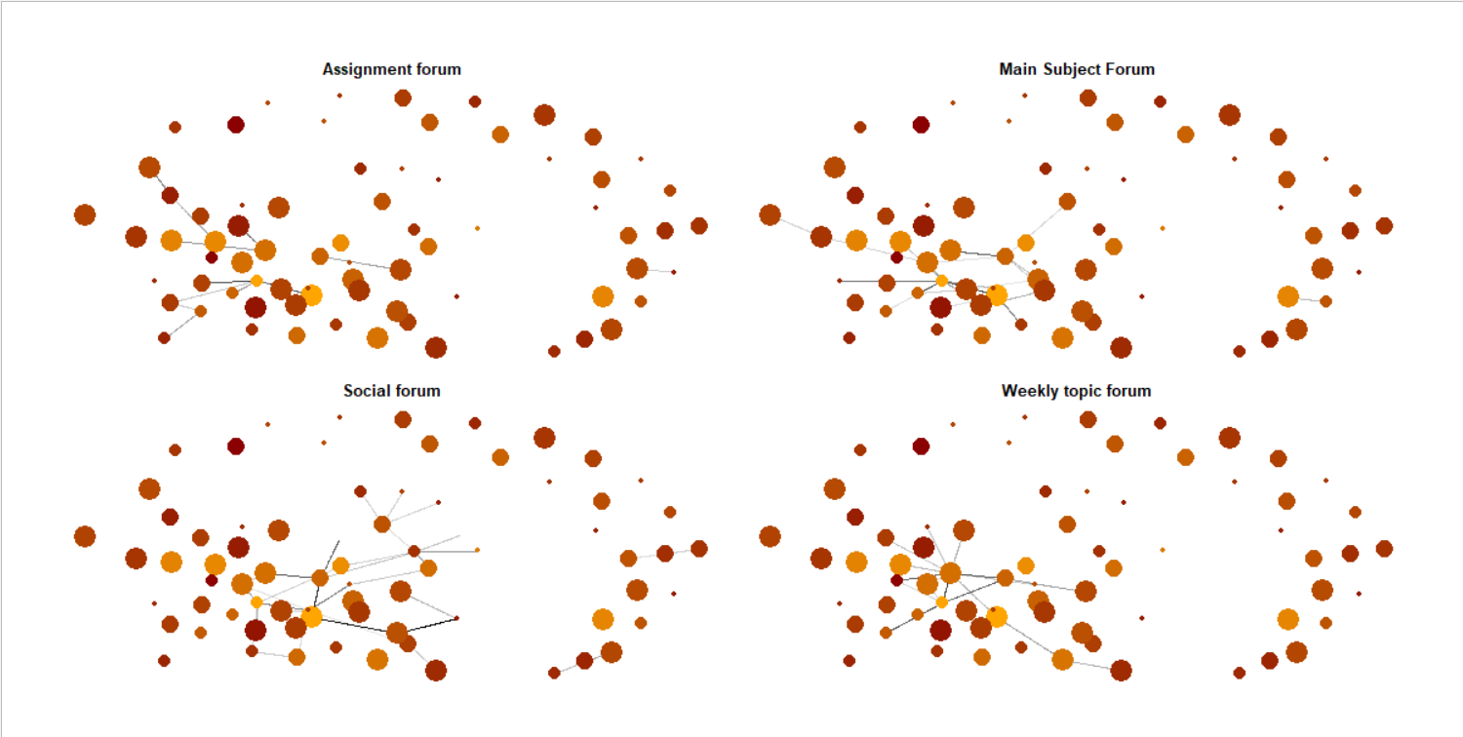
2018 Forum, teacher removed

